Slide 1




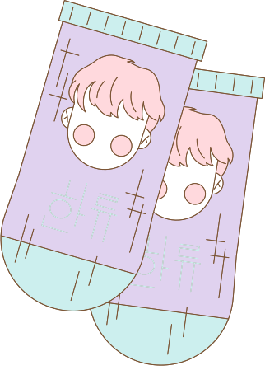


[INTEL] Edge AI SW Academy
인텔 엣지 AI 실무 프로젝트
COOK FOR YOU
강동혁 김민정 유광균 장혜원

Slide 2

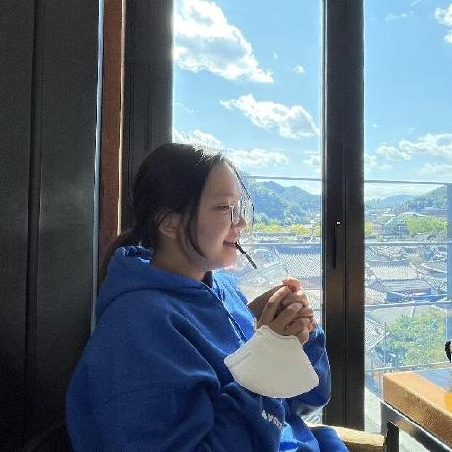



팀원 역할
PRIO
Kang Dong-hyeok
JANG HYE-WON
@DH117117
@Jang-HW
Kim min-jeong
You Kwang-Gyun
@MinJeongB
@Dbori12

Slide 3



소개
프로젝트 개요
프로젝트 목표
목차
시스템 아키텍쳐
시연
개발 과정
추후 보완점

Slide 4
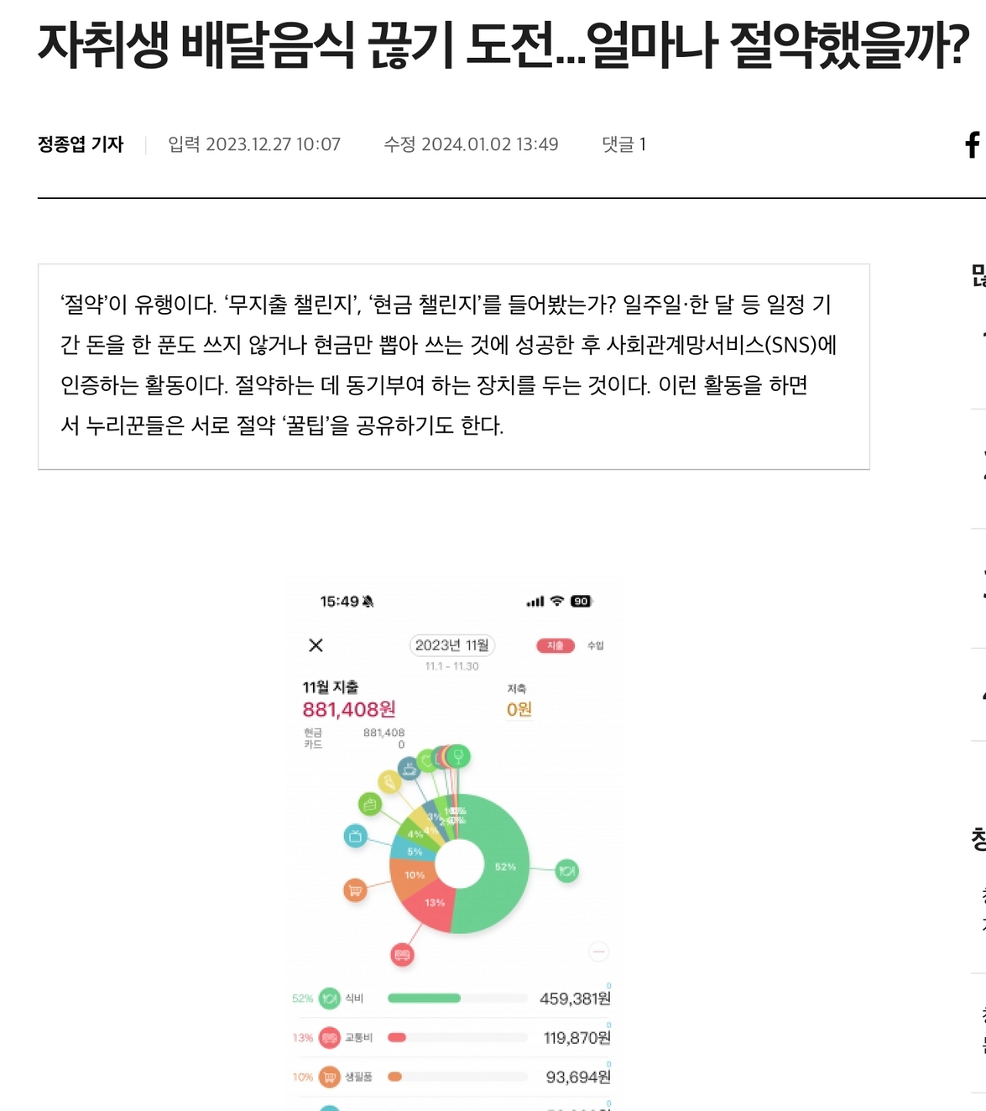
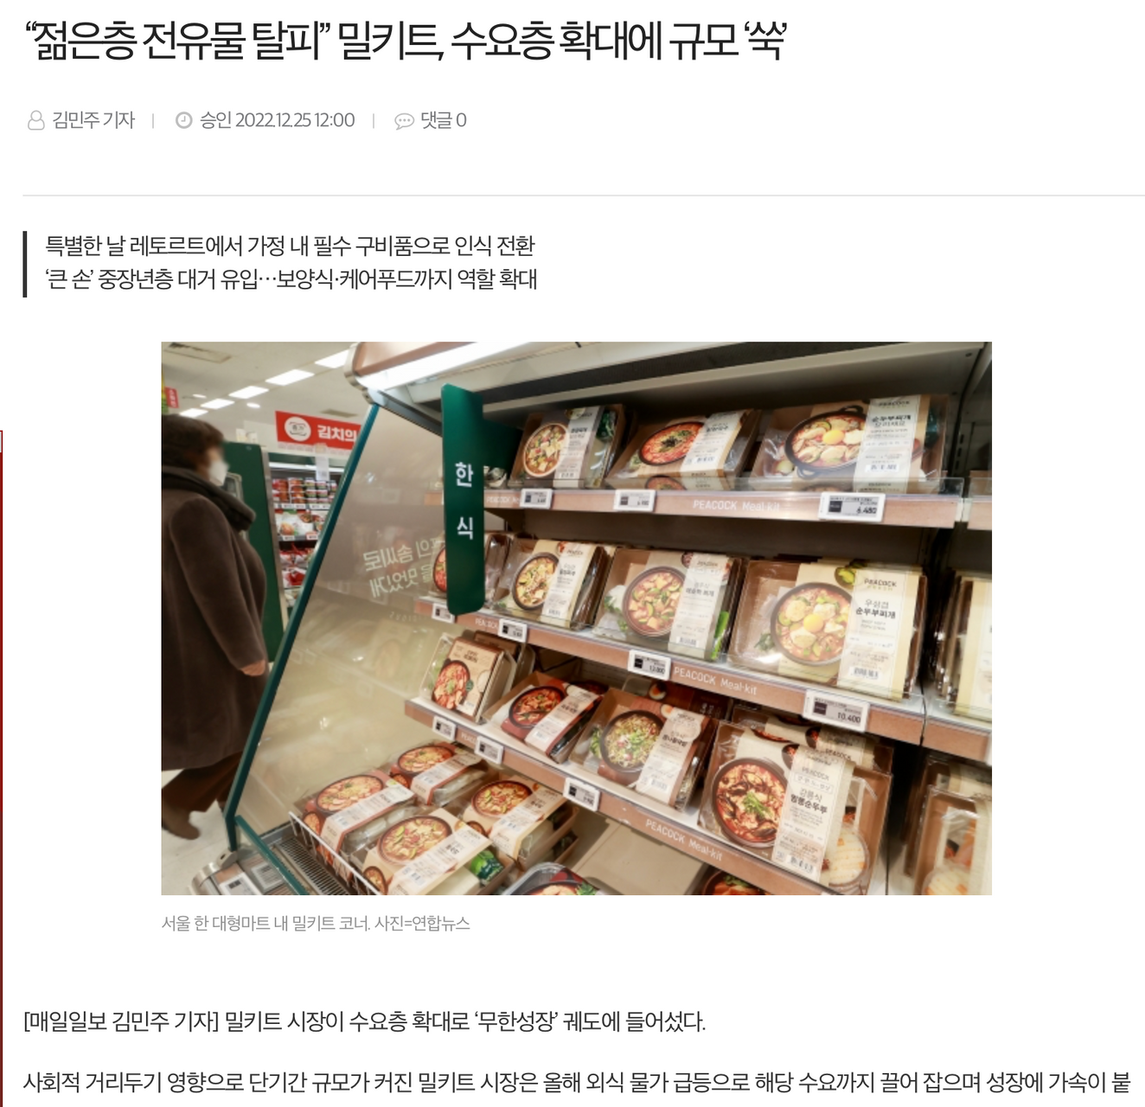
프로젝트 개요

Slide 5
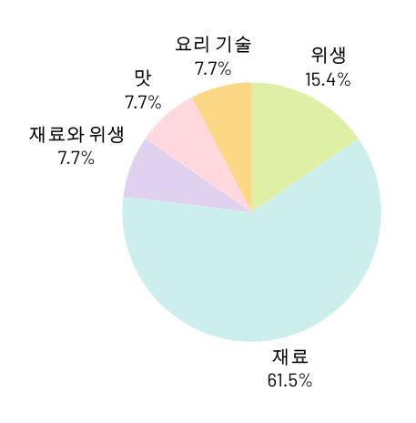

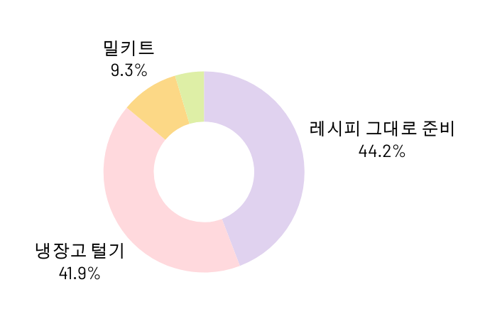
프로젝트 개요
30인을 대상으로 설문조사 실시

Slide 6






프로젝트 목표
cook for you
요리를 처음 하는 사람을 위해 제작한 프로그램
필요한 요리 재료를 알려 줘 카메라를 통해 준비한 재료를 촬영
재료가 준비 되면 해당 요리의 레시피를 출력해 요리를 쉽게 할 수 있도록 도움
@reallygreatsite

Slide 7


Tip: Create your own QR code! Click the More tab on the left and scroll down until you see the QR code generator app. Enter your URL, click the Generate Code, and your QR code should appear on your design!
My PC Wishlist
Back to Overview
LF OH seo-jun Hologram PC
I'd say this is the best Seo-jun PC but of course, all his PCs are precious!
Scan this QR code to see my PC binders for Seo-jun so far.

Slide 8




VS Code 1.89.1
Python 3.10
use TOOL
EasyOCR
EasyOCR v1.7.1
YOLOv8
Aka how close I am to completing one of my life's great purposes
asdfg
Back to Overview

Slide 9
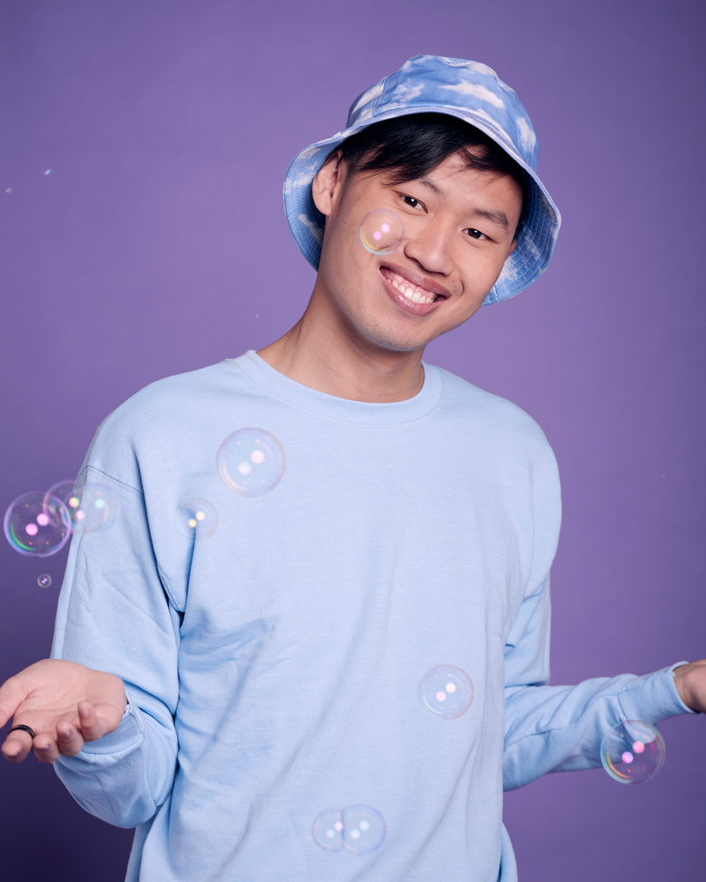
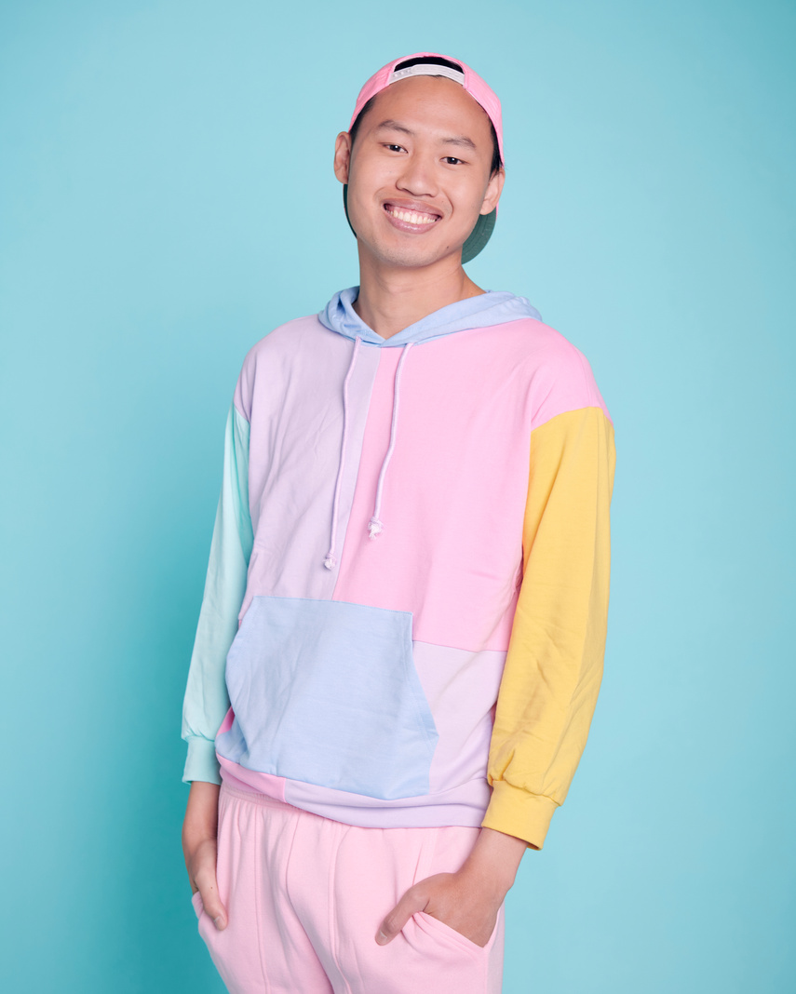




시스템 아키텍처
Laying out my Jong-suk page agenda for my binder here because these give so much sparks in my daily life.
Back to Overview

Slide 10





Photocard Holders
Seo-jun PCs
Aka how to protect my beloved bias and bias wreckers' PCs for when they finally come home to me
Back to Overview
jong-suk PCs
Baek-hyun PCs

Slide 11
Financial Sheet
Back to Overview
 | Monthly Budget | Goal Idol | Type of PC | Price | Status
January | $ 000 | Baek-hyun | Sunlight-era PC | $ 000 | Came Home
February | $ 000 | Seo-jun | Album PC | $ 000 | Prio
March | $ 000 | Jong-suk | DVD 2025 PC | $ 000 | LF
April
May
June

Slide 12




30-Day Buying Ban Tracker
Seo-jun, the most ulzzang of all, give me the strength to not buy your PC right now
Back to Overview
1 | 2 | 3 | 4 | 5 | 6 | 7 | 8 | 9 | 10
 |  |  |  |  |  |  |  |  | Hwaiting, me!
11 | 12 | 13 | 14 | 15 | 16 | 17 | 18 | 19 | 20
 |  |  |  |  |  |  |  |  | Halfway there!
21 | 22 | 23 | 24 | 25 | 26 | 27 | 28 | 29 | 30
 |  |  |  |  |  |  |  |  | Yay, it's PC shopping time!

Slide 13


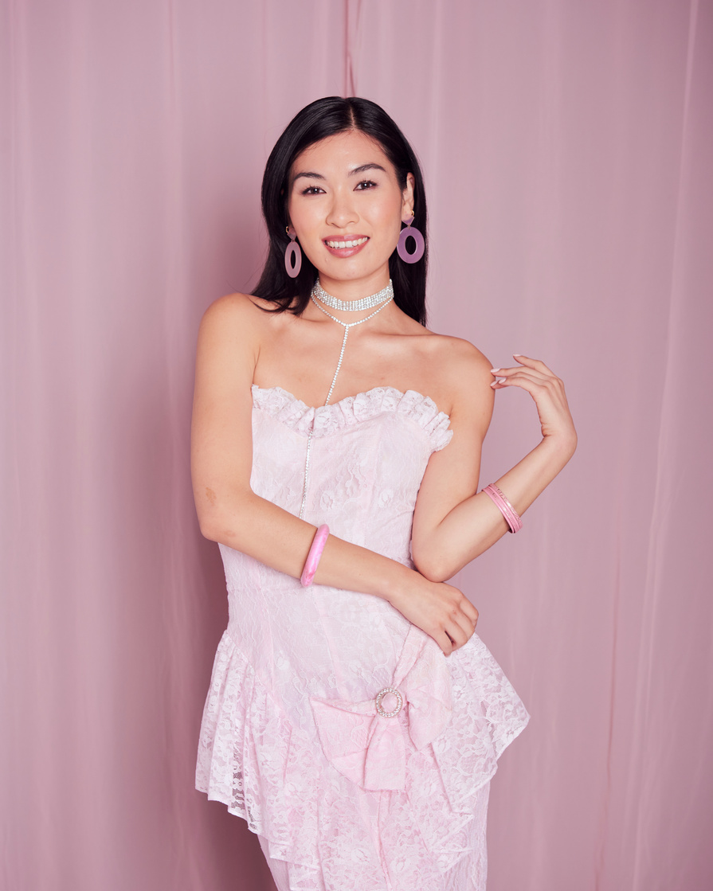
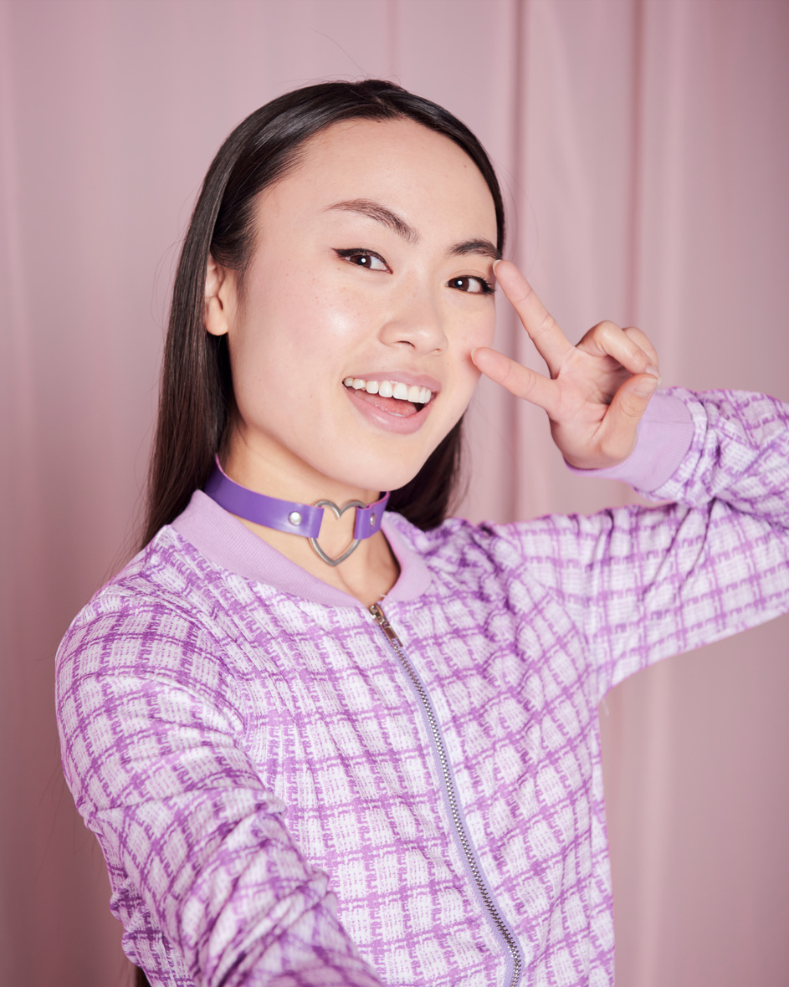
Tip: Collaboration makes teamwork easier! Click "Share" and invite your teammates to fill this up. Use this whiteboard page for bulletins, brainstorms, and other fun team ideas!
Whiteboard Page
Write a note here
Back to Overview
Write a note here
Copy a note, drag to the board, and write your ideas.
Copy a note, drag to the board, and write your ideas.

Slide 14
Add more sub-ideas
Need a timer?
Add a related idea
Add even more
sub-ideas
Add more sub-ideas
Find the clock symbol on the lower left and start brainstorming!
Add even more
sub-ideas
Add a main topic
Add a related idea
Add a related idea
Add even more
sub-ideas
Add more sub-ideas
Add a related idea
Tip: Collaboration makes teamwork easier! Click "Share" and invite your teammates to fill this up. Use this whiteboard page for bulletins, brainstorms, and other fun team ideas!
Add even more
sub-ideas
Add more sub-ideas

Slide 15












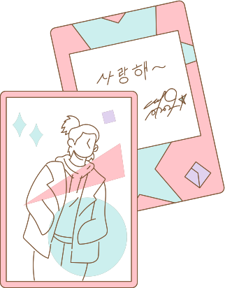




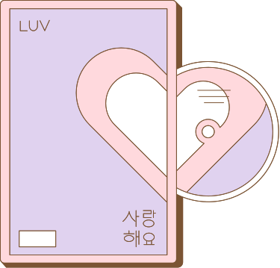



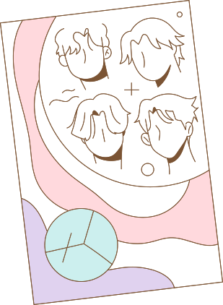


Resource Page
Use these design resources in your Canva Presentation.
Happy designing! Delete this page before presenting.

Slide 16
Resource Page
Find the magic and fun in presenting with Canva Presentations. Press the following keys while on Present mode! Delete this page before presenting.
B for blur
C for confetti
D for a drumroll
M for mic drop
O for bubbles
Q for quiet
U for unveil
Any number from 0-9 for a timer

Slide 17
